Slide 1
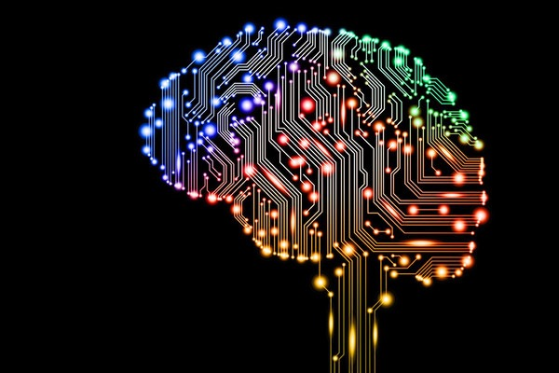

Lecture 8-1
Deep Neural Nets for Everyone
Sung Kim <hunkim+mr@gmail.com>
http://www.contagious.com/blogs/news-and-views/14054117-deep-learning-deep-insight-deeper-resonance

Slide 2

Ultimate dream: thinking machine

Slide 3
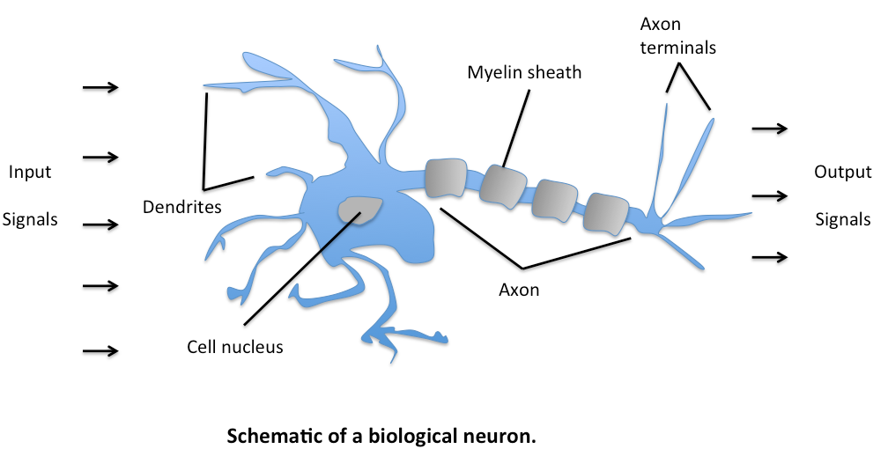
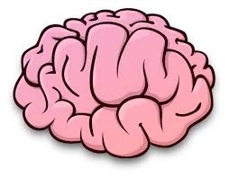
Ultimate dream: thinking machine
http://sebastianraschka.com/
Notes:
2가지 놀람: 1 너무 복잡함 - 기분 좋음
2. 유닛은 너무 간단함. 단지 수가 많을 뿐임. 10^11

Slide 4
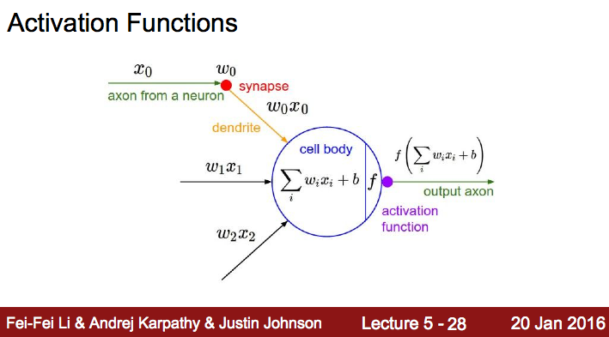
Notes:
이런 정도의 유닛은 우리도 만들수 있겠다.

Slide 5
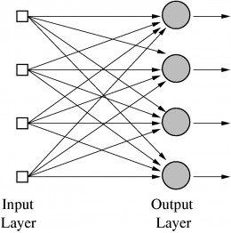
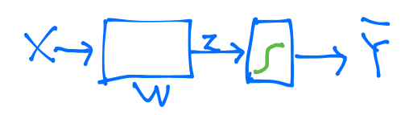
Logistic regression units
http://www.andreykurenkov.com/writing/a-brief-history-of-neural-nets-and-deep-learning/
Notes:
어디서 많이 본것? 이걸 붙여서 여러개의 출력이 되는 구조.

Slide 6
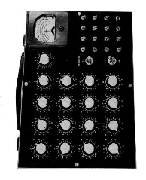
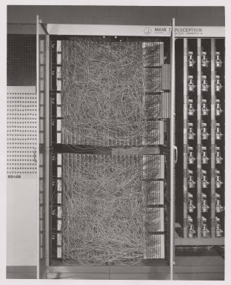


Hardware implementations
Notes:
그때는 지금과 같은 Python이 없었슴. PC도 없어서 직접 선으로 연결.
라디오 같은 것은 웨잇을 조정하는 장치.

Slide 7
False Promises
“The Navy revealed the embryo of an electronic computer today that it expects will be able to walk, talk, see, write, reproduce itself an be conscious of its existence … Dr. Frank Rosenblatt, a research psychologist at the Cornell Aeronautical Laboratory, Buffalo, said Perceptrons might be fired to the planets as mechanical space explorers” July 08, 1958
http://query.nytimes.com/gst/abstract.html?res=9D01E4D8173DE53BBC4053DFB1668383649EDE
Notes:
허풍이 너무 쎄버림 - 큰 기대….

Slide 8
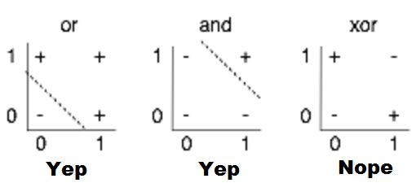
(Simple) AND/OR problem: linearly separable?

Slide 9
(Simple) XOR problem: linearly separable?

Slide 10
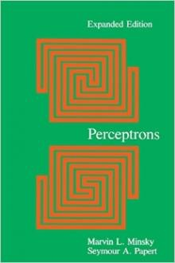
Perceptrons (1969)
by Marvin Minsky, founder of the MIT AI Lab
We need to use MLP, multilayer perceptrons (multilayer neural nets)
No one on earth had found a viable way to train MLPs good enough to learn such simple functions.
Notes:
Minsky’s book convinced most of the world that neural networks were a discredited dead-end – the worst kind of heresy.
SKynet == DeepNet, 반란군이 보낸 분일지도: Neural Network 20년 정도 발전을 늦게 함.

Slide 11
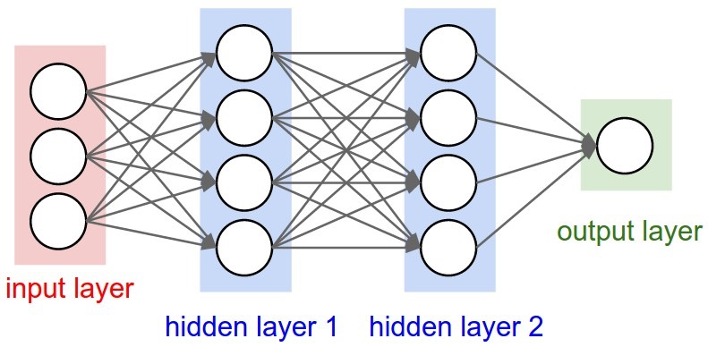
“No one on earth had found a viable way to train*”
*Marvin Minsky, 1969
http://cs231n.github.io/convolutional-networks/
Notes:
이런이야기: 몇개 더 넣어야 하는데, 나도 그 학습 방법을 모르는데, 너희도 안된다. 글을 잘 쓰신듯. 매우 설득력있었고 모두에게 받아 들여짐. AI 의 암흑기. 69-86

Slide 12
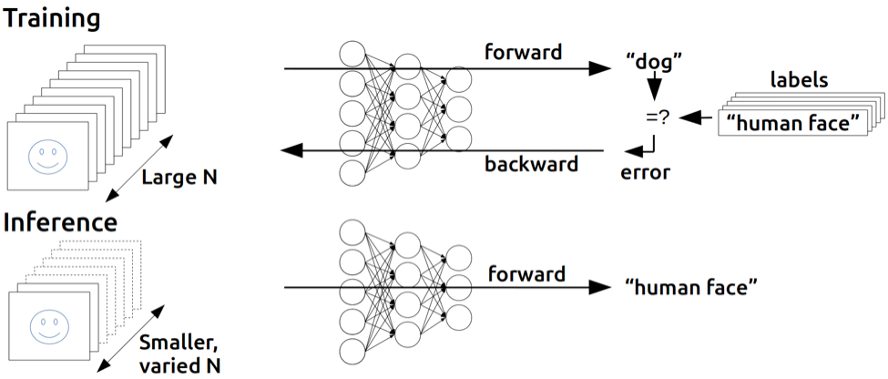
Backpropagation
(1974, 1982 by Paul Werbos, 1986 by Hinton)
https://devblogs.nvidia.com/parallelforall/inference-next-step-gpu-accelerated-deep-learning/
Notes:
민스키의 말을 듣지 않음 사람. 귓등으로 흘린분. Hinton.

Slide 13
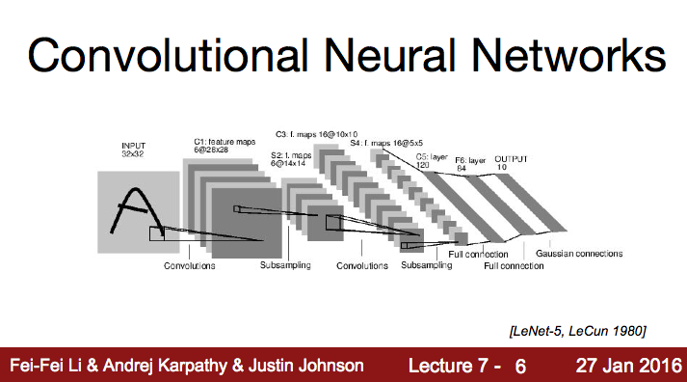
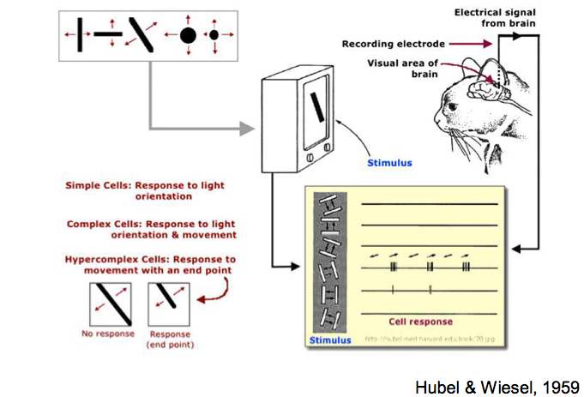
“At some point in the late 1990s, one of these systems was reading 10 to 20% of all the checks in the US.”
Notes:
다른 한편으로, 또 말 안들은 사람.

Slide 14
“At some point in the late 1990s, one of these systems was reading 10 to 20% of all the checks in the US.”
Notes:
“At some point in the late 1990s, one of these systems was reading 10 to 20% of all the checks in the US.”

Slide 15
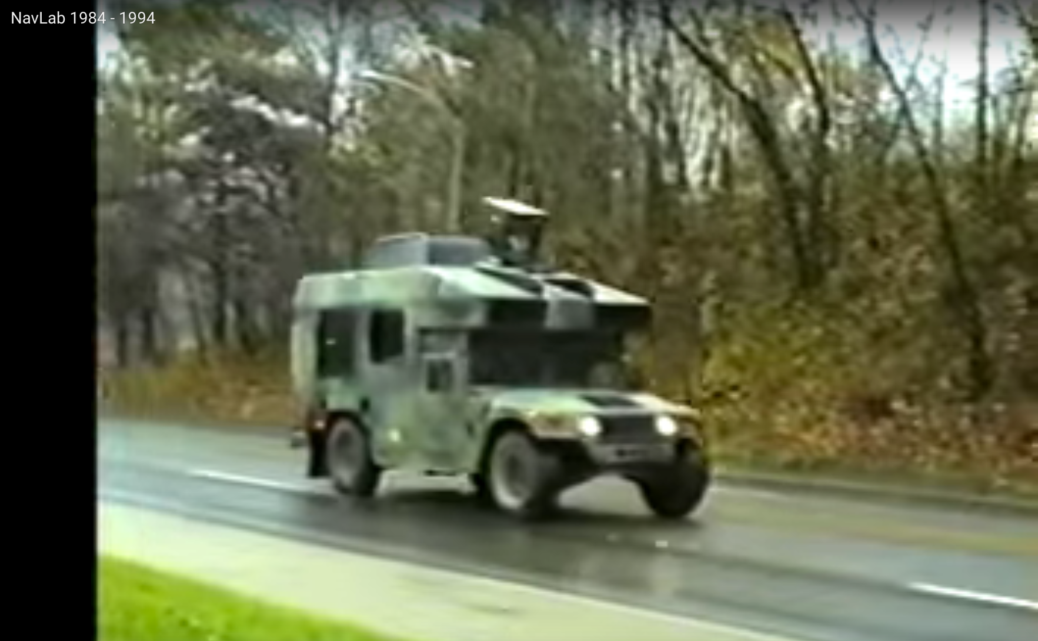
“Alvinn: An autonomous land vehicle in a neural network”
Notes:
“Alvinn: An autonomous land vehicle in a neural network”
구글자동차가 처음이 아님. 이때 차도 만들고.

Slide 16
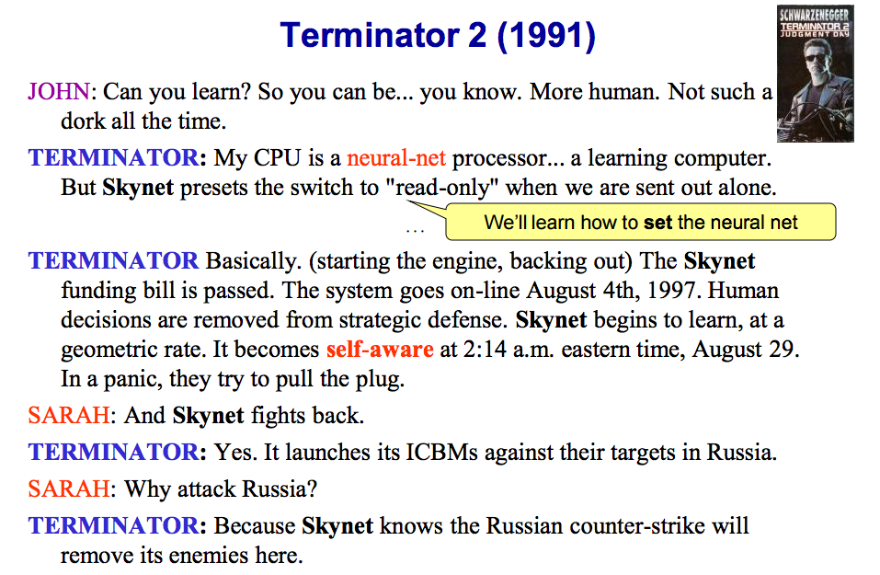
http://pages.cs.wisc.edu/~jerryzhu/cs540/handouts/neural.pdf
Notes:
터미네이터 영화에서 분명히 뉴럴넷 컴퓨터라 말합니다. 무섭~

Slide 17
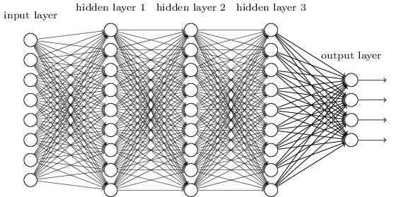
A BIG problem
Backpropagation just did not work well for normal neural nets with many layers
Other rising machine learning algorithms: SVM, RandomForest, etc.
1995 “Comparison of Learning Algorithms For Handwritten Digit Recognition” by LeCun et al. found that this new approach worked better
http://neuralnetworksanddeeplearning.com/chap6.html
Notes:
2~3개의 Hidden Layer는 Backprop으로 계산 가능.
우리는 10^11개의 있고, 간단한 일을 할때 대략 10단계를 거침.
복잡한 일을 위해 many layers가 필요.
다른애들한테 밀림. 훨씬 어려운 문제.

Slide 18

Next
To be continued…

Slide 19

CIFAR
Canadian Institute for Advanced Research (CIFAR)
CIFAR encourages basic research without direct application, was what motivated Hinton to move to Canada in 1987, and funded his work afterward.
http://www.andreykurenkov.com/writing/a-brief-history-of-neural-nets-and-deep-learning-part-4/
Notes:
친찬할만한곳, 발음하기 어려우니 C라고 합시다.

Slide 20
“Everyone else was doing something different"
“It was the worst possible time,” says Bengio, a professor at the Université de Montréal and co-director of the CIFAR program since it was renewed last year. “Everyone else was doing something different. Somehow, Geoff convinced them.”
“We should give (CIFAR) a lot of credit for making that gamble.”
CIFAR “had a huge impact in forming a community around deep learning,” adds LeCun
http://www.andreykurenkov.com/writing/a-brief-history-of-neural-nets-and-deep-learning-part-4/

Slide 21

In 2006, Hinton, Simon Osindero, and Yee-Whye Teh published,“A fast learning algorithm for deep belief nets”
Yoshua Bengio et al. in 2007 with “Greedy Layer-Wise Training of Deep Networks”

Slide 22
Breakthrough
in 2006 and 2007 by Hinton and Bengio
Neural networks with many layers really could be trained well, if the weights are initialized in a clever way rather than randomly.
Deep machine learning methods are more efficient for difficult problems than shallow methods.
Rebranding to Deep Nets, Deep Learning
http://www.andreykurenkov.com/writing/a-brief-history-of-neural-nets-and-deep-learning-part-4/

Slide 23
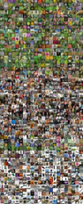
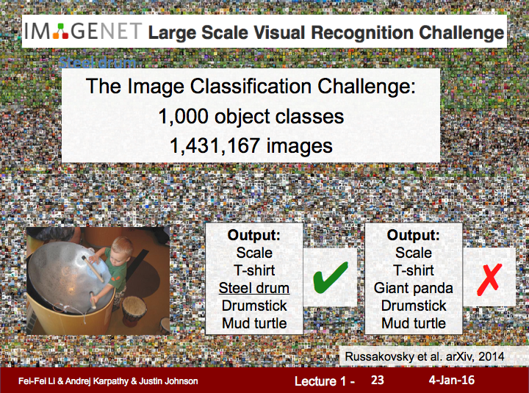
Notes:
잘 되는 구나. SVM 보다 1~2% 성능개선 좋음.

Slide 24

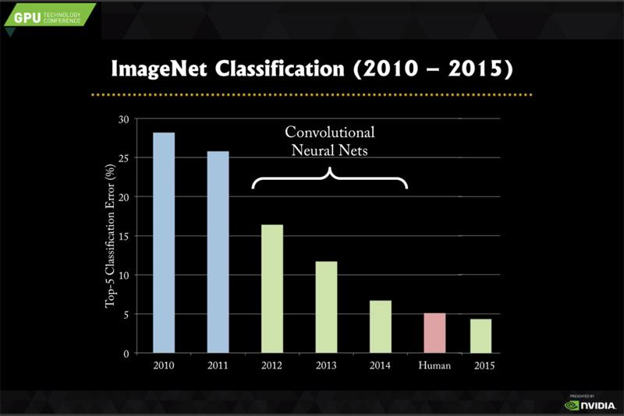
26.2% to 15.3%
Notes:
Alex, Hintton, AlexNet26.2->15.3

Slide 25
Notes:
그후로 점점 발전. 지금은 사람보다 잘함.

Slide 26
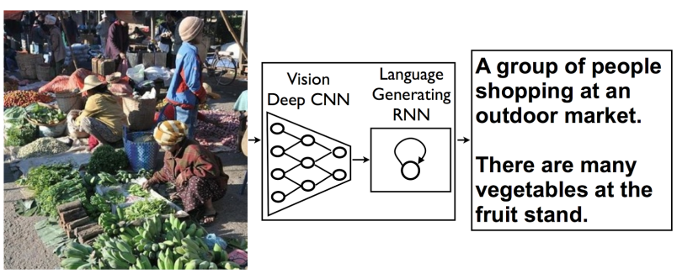
Neural networks that can explain photos
https://gigaom.com/2014/11/18/google-stanford-build-hybrid-neural-networks-that-can-explain-photos/

Slide 27
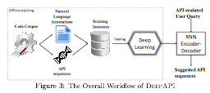

Deep API Learning*
*GU et al. at HKUST with MSRA
Notes:
65% (previous 25% correct)

Slide 28
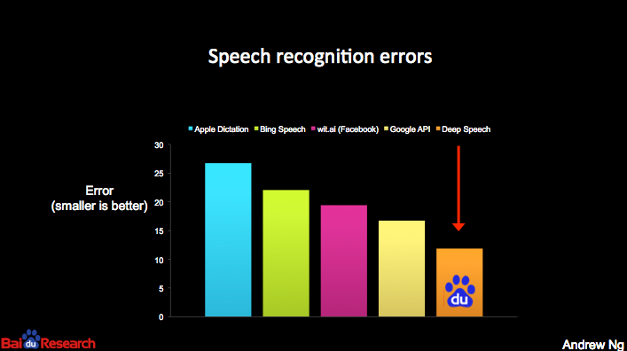

Slide 29
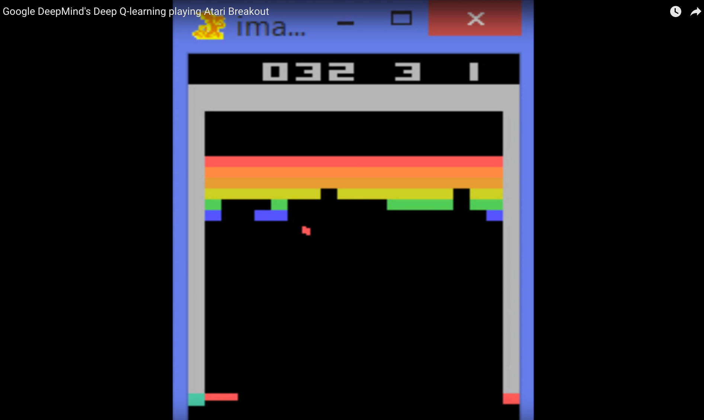
https://youtu.be/V1eYniJ0Rnk
Notes:
https://youtu.be/V1eYniJ0Rnk

Slide 30
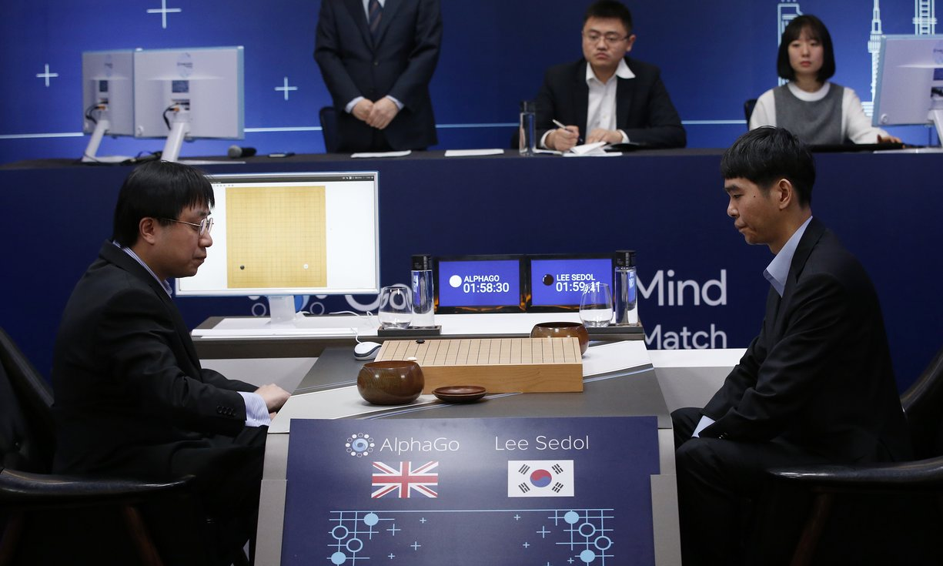

Slide 31
Geoffrey Hinton’s summary of findings up to today
Our labeled datasets were thousands of times too small.
Our computers were millions of times too slow.
We initialized the weights in a stupid way.
We used the wrong type of non-linearity.
http://www.andreykurenkov.com/writing/a-brief-history-of-neural-nets-and-deep-learning-part-4/

Slide 32
Why should I care?
I am not a researcher, not a computer scientist!
Do you have data?
Do you sell something?
Are doing any business?

Slide 33
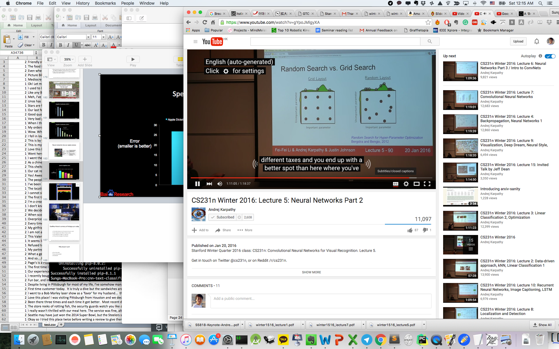

Slide 34
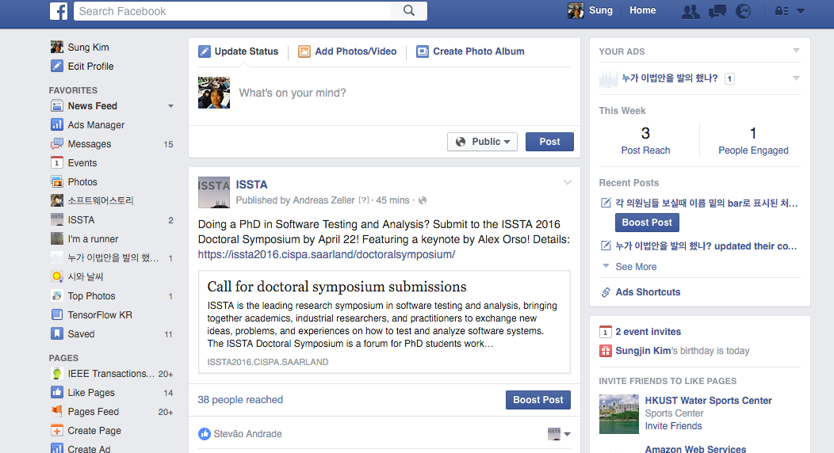

Slide 35
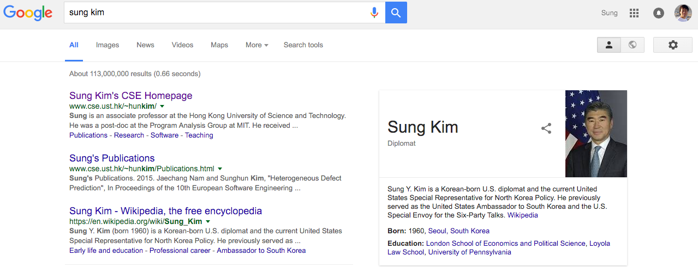

Slide 36


Slide 37


Slide 38
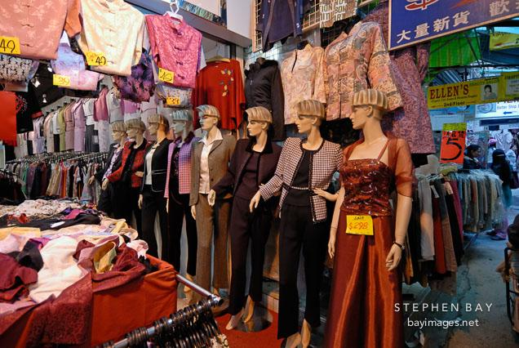

Slide 39
Why Now?
Students/Researchers
Not too late to be a world expert
Not too complicated (mathematically)
Practitioner
Accurate enough to be used in practice
many ready-to-use tools such as TensorFlow
Many easy/simple programming languages such as Python
After all, it is fun!

Slide 40
Next
Neural Nets Basic with XOR!

